Slide 1
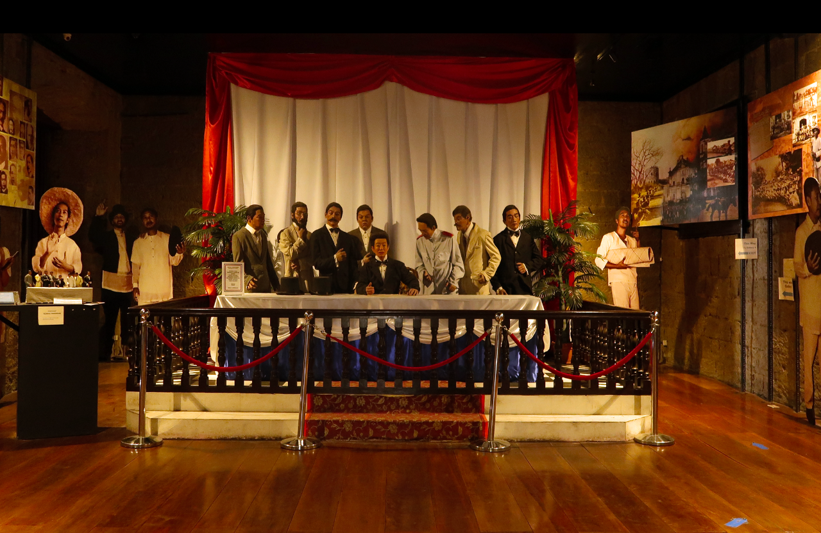
Malolos Constitution

Slide 2
The Constitution, whether written or unwritten is recognized as the supreme law of the land as it serves as the basis for the legitimacy of any governmental acts necessary for its existence. It is a codified law that determines the powers and duties of a government and it embodies certain right of the people.

Slide 3
MALOLOS CONSTITUTION of 1898
The First Philippine Republic
The Historical Underpinnings in the Enactment of Malolos Constitution of 1898
THE REVOLUTION:
The “Cry” of Pugadlawin August 23, 1896: Bonifacio and members of the Katipunan tore up their cedullas shouting: “Long Live the Philippines”, as an act that represented their emancipation from Spain’s colonial rule.

Slide 4
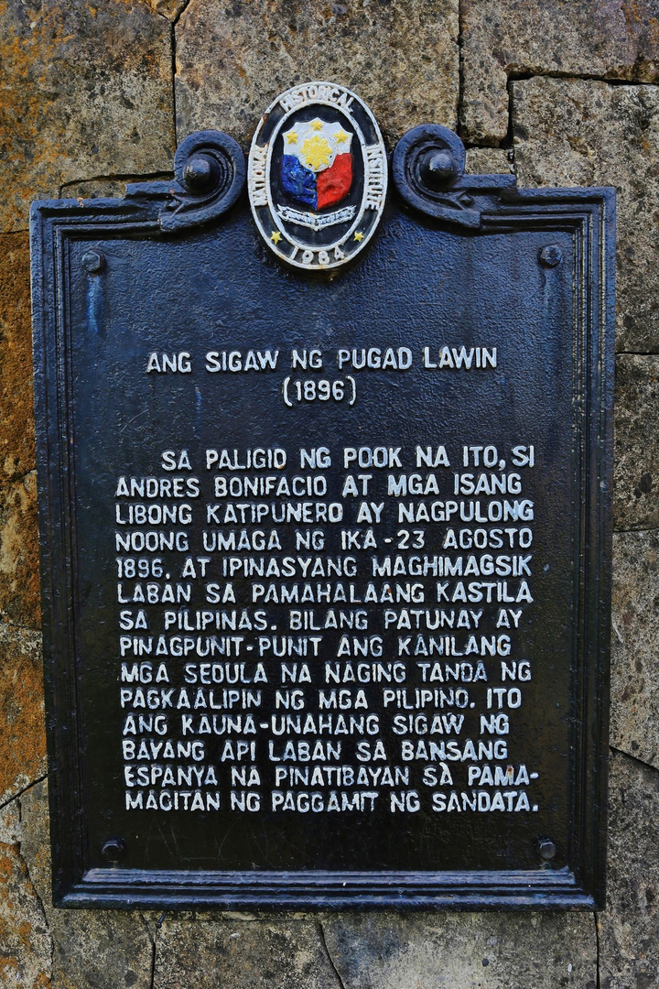
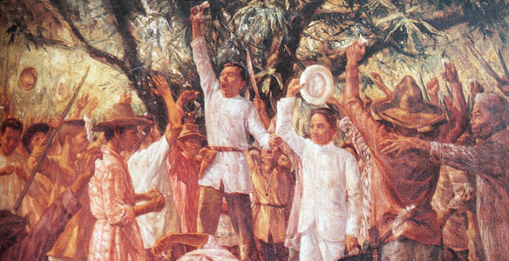
“The Cry of Pugadlawin”

Slide 5
The Katipunan in Cavite
Katipunan in Cavite was divided into two factions representing two provincial councils.
The Magdalo: led by Baldomero Aguinaldo, with headquarters at Cavite el Viejo (now Kawit)
The Magdiwang: led by Mariano Alvarez, with headquarters at Noveleta.

Slide 6
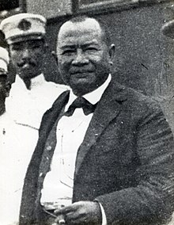

Magdalo Flag
Baldomero Aguinaldo

Slide 7
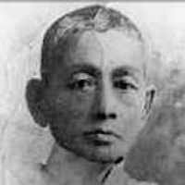

Flag of Magdiwang
Mariano Alvarez

Slide 8
Bonifacio in Cavite
The rivalry that existed between the Magdalo and Magdiwang factions of the Katipunan in Cavite led to a series of reverses early in January 1897.
To patch up matters the Magdiwang faction invited Andres Bonifacio to intervene in the conflict. At first Bonifacio refused, saying that his presence in Morong was necessary. But upon the insistent request of Artemio Ricarte and Mariano Alvarez, Bonifacio accepted the invitation
On December 31, an assembly of revolutionists was held at Imus to determine whether the Katipunan should be superseded by another form of government.

Slide 9
A. The Magdalo faction believed that with the outbreak of the revolution, the Katipunan had ceased to be a secret society and should, therefore, be superseded by one more keeping with the demands of the period.
B. The Magdiwang men on the other hand, contended that the Katipunan should remain the government of the revolutionist because it already had a Constitution and by-laws recognized by all.

Slide 10
The Tejeros Convention
March 22, 1897: The two factions again met at Tejeros, a barrio of San Francisco de Malabon. The convention was held at the estate- house of the friars which the rebels had captured.
The session opened at about two o’clock in the afternoon with Jacinto Lumbreras, a Magdiwang, as presiding officer, and Teodoro Gonzales, also a Magdiwang, as a secretary. Severino de las Alas, a Magdiwang, took the floor and suggested that the convention assembled should solve the problem of whether a new government should be established to take the place of the Katipunan. This suggestion led to one heated argument after another until both camps almost came to blows.

Slide 11
The convention adopted this principle unanimously.
With this thorny question resolved, the Republic of the Philippines was proclaimed. This proposal was approved and the election got underway. Elected were:
President: Emilio Aguinaldo
Vice-President: Mariano Trias
Captain-General: Artemio Ricarte
Director of War: Emiliano Riego de Dios
Director of the Interior: Andres Bonifacio

Slide 12
The Biyak-na-Bato Republic
A republican government was established at Biyak- na- Bato, known as the Biak- na- Bato Republic. The provisional constitution of this Republic was prepared by Felix Ferrer and Isabelo Artacho, who copied almost word for word, the Cuban constitution of Jimaguayu. The Biyak- na- Bato Constitution was signed on November 01, 1897. Its Preamble states:

Slide 13
The separation of the Philippines from the Spanish monarchy and their formation into an independent state with its own government called the Philippine Republic has been the end ought by the Revolution in the existing war, begun on the 24th of August, 1896; and, therefore, in its name and by the power delegated by the Filipino people, interpreting faithfully their desire and ambitions, we, the representatives of the Revolution, in a meeting at Biak- na- Bato, November 01, 1897, unanimously adopted the following articles for the Constitution of the State.

Slide 14
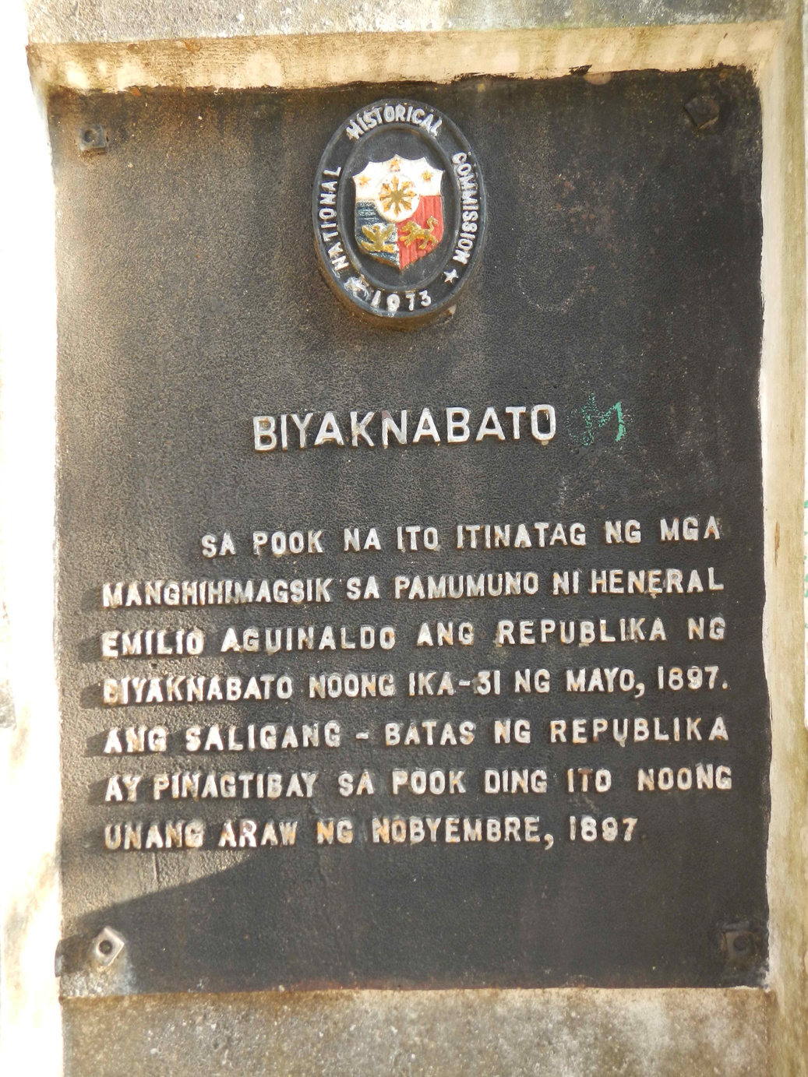
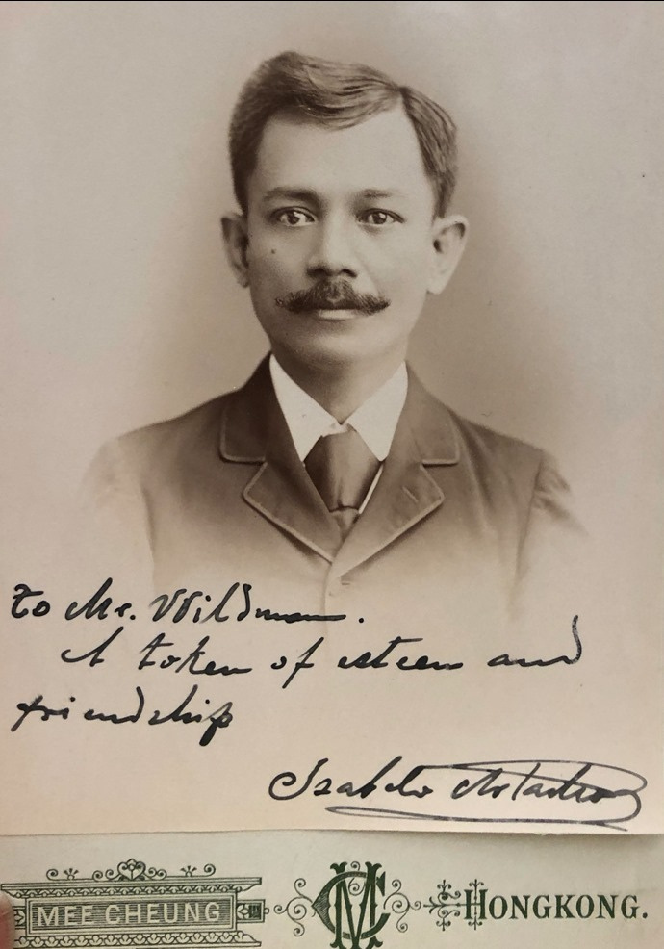
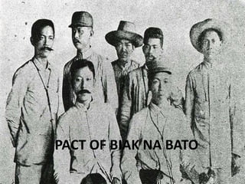
Isabelo Artacho

Slide 15
The Constitution provides for the creation of a Supreme Council composed of a President, a Vice-President, a Secretary of War, and a Secretary of the Treasury. Article VIII reflects the nationalism of the revolutionists, for it provides that “Tagalog shall be the official language of the Republic.”
The constitution also provides the religious liberty freedom of education, freedom of the press, as well as the freedom to exercise any of the professions. In accordance with Article I, the Supreme Council was created on November 02 with the following as officers:

Slide 16
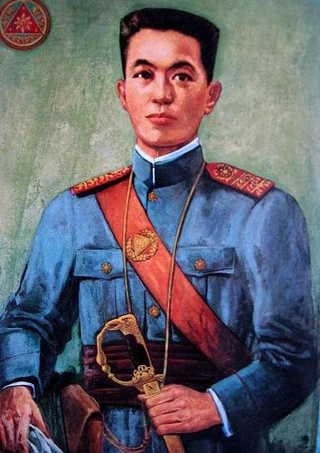
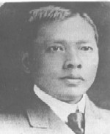

Secretary of the Interior: Isabelo Artacho
President: Emilio Aguinaldo
Vice- President: Mariano Trias

Slide 17

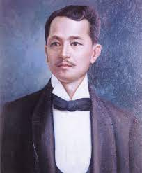
Secretary of Foreign Affairs: Antonio Montenegro
Secretary of the Treasury: Baldomero Aguinaldo
Secretary of War: Emiliano Riego de Dios

Slide 18
Aguinaldo issued a proclamation in July entitled “To the Brave Sons of the Philippines” in which he listed the revolutionary demands, namely:
The expulsion of the friars and the return to the Filipinos of the lands they appropriated for themselves.
Representation in the Spanish Cortes
Freedom of the press and tolerance of all religious sects
Equal treatment and pay for Peninsular and Insular civil servants
Abolition of the power of government to banish citizens
Legal equality for all persons.

Slide 19
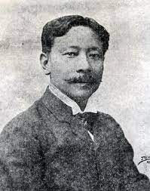
The Truce of Biyak-na-Bato
Pedro Paterno: A mestizo who negotiated with Aguinaldo and Primo de Rivera on the conditions that he thought would be satisfactory to both.
The resulting Truce provide, among other things:
That Aguinaldo and his companions would go into involuntary exile abroad
That Primo de Rivera would pay the sum of 800,000php to the rebels in three installments:
a. 400,000php to Aguinaldo upon his departure from Biyak- na- Bato.
b. 200,000php when the arms surrendered by the revolutionist exceeded 700
c. The remaining 200,000php when the Te Deum was sung and general amnesty proclaimed by the governor.
3. That Primo de Rivera would pay the additional sum of 900,000php to the families of non- combatant Filipinos who suffered during the armed conflict

Slide 20
THE MALOLOS CONSTITUTION:
Aguinaldo returns to the Philippines from Hong Kong with a plan to form a Filipino government. To show the capacity of the Filipinos for self- government, Aguinaldo established a dictatorial Government in May and, a month later, the Revolutionary Government. Different departments were created to take charge of the multifarious duties of the new government.

Slide 21
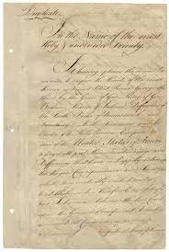
In September, the Congress was convoked at Malolos and a constitution prepared to guide the government in its progress towards republicanism. Diplomatic agents were sent abroad to work for the recognition of the Philippine independence. But the United States, however, had decided to take over control of the Philippines, and in December 1898, the Treaty of Paris between Spain and the United states was concluded. The treaty gave the Philippines to the United States. Even so, the Filipino leaders proclaimed the Philippine Republic in Malolos with Aguinaldo as President.

Slide 22
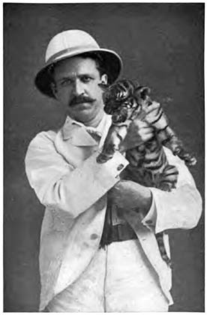
The Dictatorial Government
In the wake of his military victories, Aguinaldo decided that it was time to establish a Filipino government. He had with him when he arrived from Hong Kong a draft of a plan prepared by Mariano Ponce for the establishment of a revolutionary government: Consul Wildman, however, had advised Aguinaldo earlier to establish a dictatorial government which later on could be the nucleus of a republican government similar to that of the United States.
Consul Rousenvelle Wildman

Slide 23
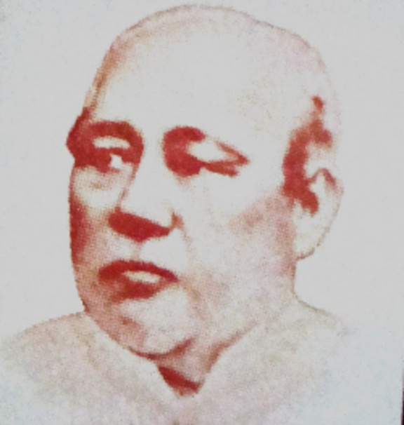
Probably because the critical times demanded government with a strong executive, Ambrosio Rianzares Bautista, Aguinaldo’s adviser, told him to form a dictatorial government. Consequently, Aguinaldo made known his intention of establishing such form of government when he announced, in the morning of May 24, 1898, that he was assuming “Command of all the troops in the struggle for the attainment of our lofty aspirations, inaugurating a dictatorial government to be administered by decrees promulgated under my sole responsibility…”
Later in the day, he issued a decree nullified the orders issued under the authority of the Biyak- na- Bato Republic and asserted that the Dictatorial Government, was temporary in nature, “so that, when peace shall have been reestablished and our legitimate aspiration for unregistered liberty attained, it may be modified by the nation, in which rests the principle of authority.”
Ambrosio Rianzares Bautista

Slide 24
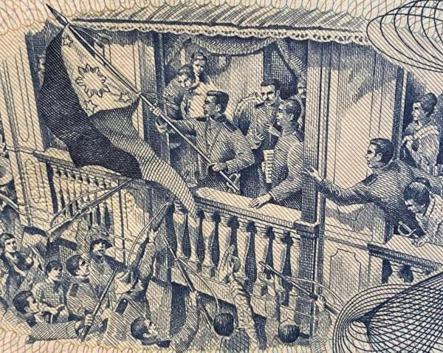
Declaration of Independence
On June 5, Aguinaldo issued a decree setting aside June 12 as the day for the proclamation of the Philippine independence.

Slide 25
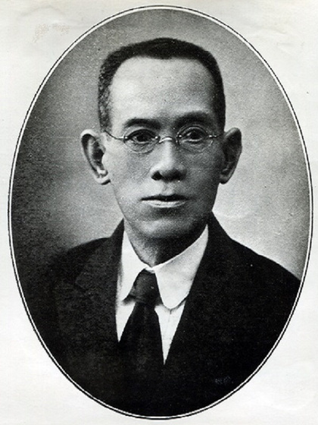

Aguinaldo commissioned Julian Felipe, a composer from Cavite, to prepare a composition which would be played during the independence ceremonies. On June 11, Felipe showed Aguinaldo the draft of his musical composition, which was entitled Marcha Filipina Magdalo. Aguinaldo and other revolutionary leaders, upon hearing the composition played on the piano, adopted it as the official march of the Philippines. Aguinaldo then requested Felipe to teach the music to the members of the band of San Francisco de Malabon so it could be played the next day. Felipe changed the title of the march to Marcha Nacional Filipina (Philippine National March).
Julian Felipe

Slide 26
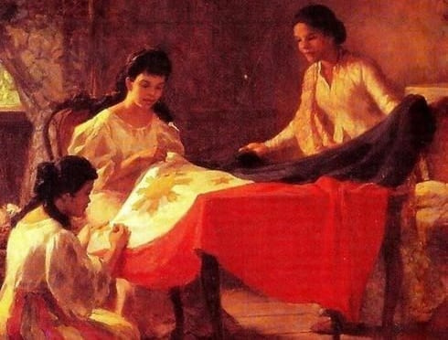
June 12, 1898, between four and five in the afternoon, Aguinaldo in the presence of a huge crowd, proclaimed the independence of the Philippines at Cavite el Viejo (Kawit). For the first time, the Philippine National flag, made in Hong Kong by Mrs. Marcela Agoncillo, assisted by Lorenza Agoncillo and Delfina Herboza, was officially hoisted and the Philippine National March played in public
The Act of the Declaration of the Independence was prepared by Ambrosio Rianzares Bautista, who also read it. A passage in the Declaration reminds one of another passage in the American Declaration of Independence. The Philippine Declaration was signed by 98 persons, among them an American army officer who witnessed the proclamation.

Slide 27
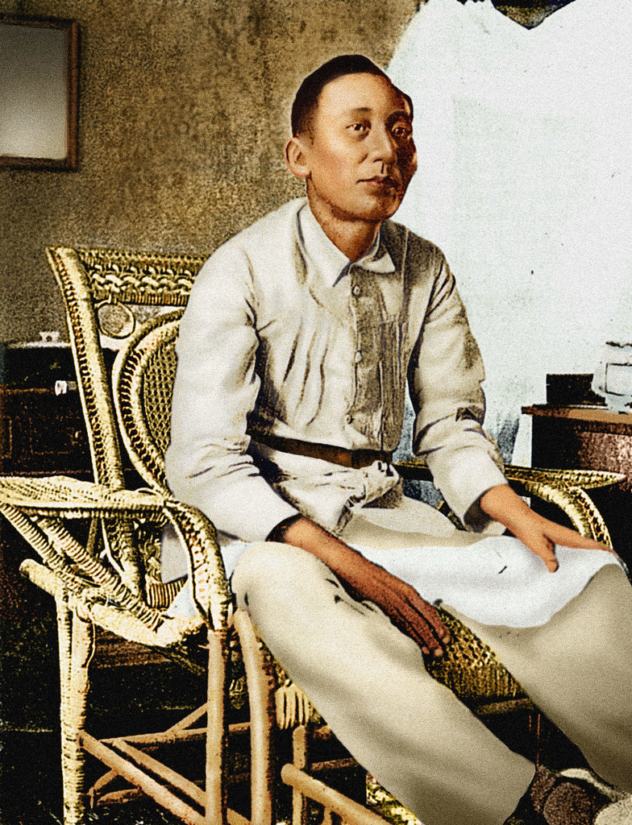
Apolinario Mabini
Born of very poor parents, Inocencio Mabini and Dionisia Maranan, in Talaga Tanawan, Batangas. Mabini studied in a school in Tanawan, and then conducted by a certain Simplicio Avelino. Much later, he transferred to a school conducted by the famous pedagogue, Father Valerio Malabanan. He continued his studies at San Juan de Letran and at the University of Santo Tomas, where he received his law degree in 1894.
Early in 1896, he contracted an illness, probably infantile paralysis that led to the paralysis of his lower limbs.
Mabini was Aguinaldo’s trusted adviser.
Envious enemies called him the “Dark Chamber of the President”, but the admirers considered him the “Brains of the Revolution”.

Slide 28
Re-organization of Local Government
Because Mabini believed in order, he prepared a decree for Aguinaldo’s signature. Believing in the democratic principles, Mabini inserted in the decree a statement to the effect that it was “the first duty of the government to interpret faithfully the popular will.” Mabini wanted Aguinaldo to be surrounded by representatives close to the State could take measures to meet those needs. Consequently, the Decree of June 18, 1898 provided for the reorganization of local government in those provinces already freed from Spanish control. Made electors were those inhabitants who were prominent for their high character and social position.
These electors were to elect the town chief the headman for each barrio, and three delegates, namely:
a. The delegate for police and internal order
b. The delegate for justice and civil registry
c. The delegate for taxes and property

Slide 29
The town chief, the headmen of the barrios, and the three delegates constituted the Popular Assembly. The town chief was to act as president of the assembly, with the headman of the Poblacion or town proper as vice-president, and the delegate for justice and civil registry as secretary.
The chiefs of the town, in consultation with their respective popular assemblies elected the provincial chief and three councilors. The provincial chief, the chief of the capital of the province, and the three councilors constituted the Provincial Council, whose chief duty was to propose measures for the general welfare of the inhabitants of the province.
The decree also provided for the election of delegates from each province who would constitute the Revolutionary Congress. These delegates to the Congress were made as follows: for the city of Manila and the province of Cavite, three delegates each; for the province of the first class, two delegates each; for the rest of the provinces, one delegates each.
The main function of the Revolutionary Congress was, according to the decree, “to propose… measure concerning the preservation of internal order and external security of these islands…” In order to secure maximum efficiency in the implementation of the rules regarding the holding of elections, the decree provided for the appointment of a commissioner of the Central Government for each province. The military commanders who liberated any town from the Spaniards became automatically commissioners “by virtue of their office.”

Slide 30
The Revolutionary Government
The Dictatorial Government lasted for only a month, from May 24 to June 23, 1898. At the instance of Mabini, Aguinaldo delivered on June 23 a message, penned by Mabini, giving his reasons for changing the form of government to revolutionary one. On the same day, Aguinaldo issued a decree setting up the Revolutionary Government. It changed the title of the chief of state from Dictator to President and defined the object of the government as the “struggle for the independence of the Philippines until all nations, including the Spanish, shall expressly recognize it, and to prepare the country so that the true republic may be established.”
To help the President in his duties, four departments were created, namely:
a. The Department of Foreign Affairs, Navy and Commerce
b. The Department of War and Public Works
c. The Department of Police and Internal Order, Justice, Education and Hygiene
d. The Department of Finance, Agriculture and Manufacturing Industry

Slide 31
The decree also provide for the creation of Congress. As has been seen, the decree of June 18 provided for the election of delegates from each province to represent it in Congress. The decree of June 23 provided that in those provinces which had not been pacified, that is to say; provinces were to be appointed by the President. The powers of the Congress were defined as follows:
To watch over the general interest of the Philippine people, and the carrying out of the revolutionary laws; to discuss and approve prior to their ratification, treaties and loan; to examine and approve the accounts prosecuted annually by the Secretary of Finance, as well as extraordinary and other taxes which may be hereafter imposed.

Slide 32
On July 15, 1898, Aguinaldo made his first cabinet appointments: Baldomero Aguinaldo, Secretary of War and Public Works; Leandro Ibarra, Secretary of the Interior; and Mariano Trias, Secretary of Finance. Cayetano Arellano was offered the secretary ship of foreign affairs, but he declined, feigning illness, although actually he was in sympathy with the American and would not, therefore, give his services to the Filipino government
Later, Mabini accepted the position and thereby became a member of the President’s official family. On September 28, Aguinaldo increased the number of departments to six namely, foreign affairs, war interior, welfare, justice and treasury.

Slide 33
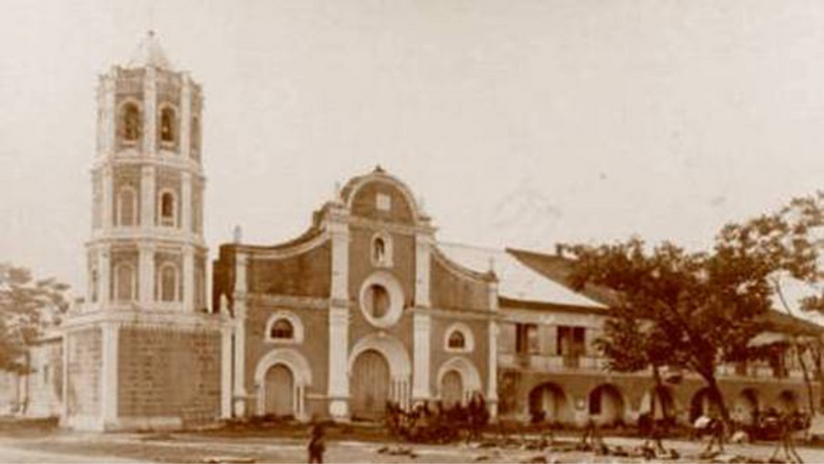
The Malolos Congress
In accordance with the decrees of June 18 and 23, 1898, Aguinaldo convoked the Revolutionary Congress at Barasoain, Malolos. Peace and order conditions in some provinces were such that Aguinaldo was compelled to appoint their delegates to Congress. Consequently, on September 4, he appointed fifty delegates to the Congress. This number was increased by ten on September 10. The number of delegates to the Congress fluctuated from time to time.
In the morning of September 15 the basilica of Barasoain was filled with delegates and spectators. Outside, the Banda Pasig played National Anthem.

Slide 34
When Aguinaldo and his officers arrived, the delegates, the cream of the Filipino intelligentsia, spread out to give way to the President. With the President seated, the secretary read the names of the delegates, after which Aguinaldo was introduced. Cries of “Viva!” reverberated and Aguinaldo acknowledged the applause of the throng. Then he stood up and read his message, first, in Tagalog and then in Spanish.
Aguinaldo then announced that the Congress was to convene after electing its officers.
In the afternoon, the Congress proceeded to elect its officers, namely, Pedro A. Paterno, President; Benito Legarda, Vice President; Gregorio Araneta, first Secretary; and Pablo Ocampo, second Secretary.
In the Congress meeting of September 17, delegates created the Permanent Commission of Justice as provide for in the decree of June 23. In the afternoon, eight committees of Congress were constituted:
a. The committee on felicitation
b. The committee on message
c. The committee on internal regulations
d. The reception committee
e. The budget committee
f. The committee on festivities
g. The committee on style
h. The committee for drafting the constitution

Slide 35
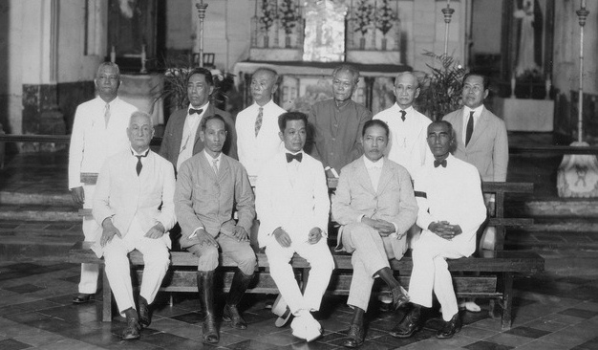
Malolos Constitution
The first significant act of the Congress was ratification, on September 29, of the independence proclaimed at Kawit on June 12. Aguinaldo, whose office and official residence were locating at the convent of the Barasoain Church in Malolos, where Congress was holding its sessions, amidst the “vociferous acclamation of the people and the strains of music.” The ceremonies began at 10:30 a.m., and Aguinaldo, after congratulating Paterno for having been elected to the presidency of Congress, partly said in Tagalog:
“Now we witness the truth of what the famous President Monroe said to the effect that the United States was for the Americans; now I say that the Philippines is for the Filipinos.”

Slide 36
In preparing the decree of June 18 and that of June 23, Mabini envisioned the Congress to be an advisory body of the President. He believed that in such period as the country was passing through, it was necessary to have a strong Executive. But his idea was contradicted by Congress when it proposed to draft a constitution.
Moreover, Mabini added that Congress was convoked not to frame a constitution, but to advise the President and to give him popular support. Mabini was, however, in the minority, and although his arguments were unassailable, he was defeated by the majority under the leadership of Paterno. Nevertheless, Mabini submitted his Constitutional Plan of the Philippine Republic, but the Congress, for the second time, overruled him.
A committee to draft the constitution was created, with Felipe G. Calderon as its most important prominent member. Having set Mabini’s Constitutional Program aside, the committee, under the influence of Calderon, also set aside, but in a subtle manner, Paterno’s constitutional plan, which smelled strongly of the Spanish Constitution of 1869. With the advice of Cayetano Arellano, a brilliant but unreconstructed mestizo
Calderon drew up his plans for a constitution, deriving inspiration from the constitutions of Mexico, Belgium, Guatemala, Costa Rica, Brazil, and France.

Slide 37
The most tumultuous discussion occurred when the provision making Catholicism the religion of the State came up for consideration. After much heated debates on the subject, the Congress voted on it. The result was a tie.
The second voting resulted in the victory of the separation of the Church and State. The partisans of separation won by only one vote- that of Pablo Tecson. Thus, the Calderon project of making Catholicism the State religion was defeated. The provision on the subject of state religion was then amended to read:
Article 5. - The State recognizes the freedom and equality of all religions, as well as the separation of the Church and the State.

Slide 38
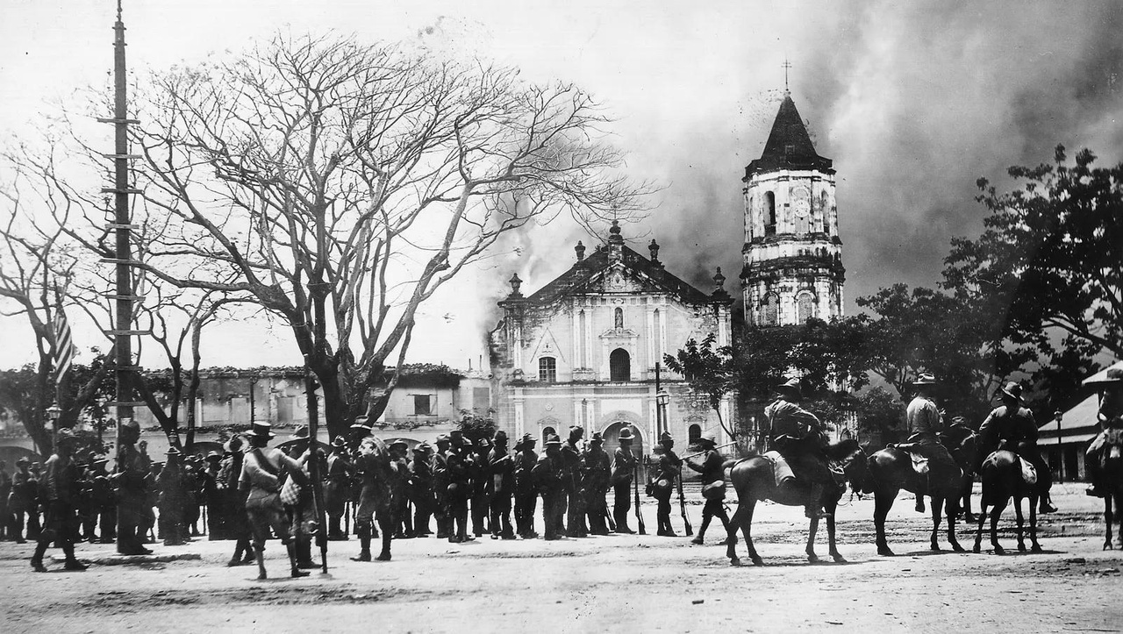
A few other amendments were inserted in the draft constitution before it was sent to Aguinaldo for approval. On January 21, 1899, Aguinaldo promulgated what is now known as the Malolos Constitution.
The protracted discussion that characterized the Congress sessions on the subject of whether or not Church and State should be united showed, first, that the Filipinos as a people, though up in arms against Catholic Spain, were not anti- Catholic but merely anti- clerical, and second that many of the delegates learned from the bitter lesson of Philippine history in voting against the union of Church and State which, under Spain, was the fundamental basis of Spanish colonial system.
That decision became the cornerstone of the Philippine democracy and showed not only the nationalism and democratic orientation of those who voted for the separation of Church and State, but also their keen sense of history.

Slide 39
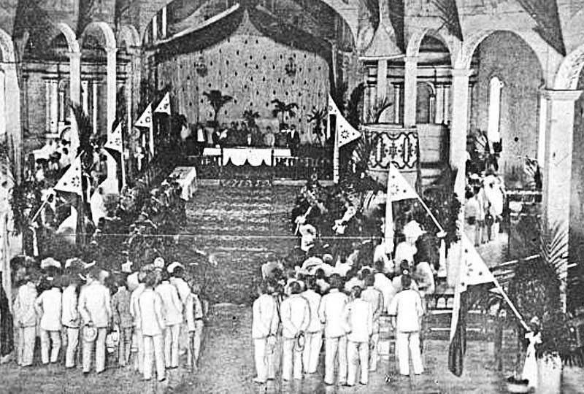
The Philippine Republic
On January 21, 1899, Aguinaldo finally promulgated the Constitution. He formed his Cabinet as follows:

Slide 40
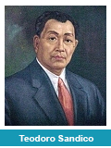
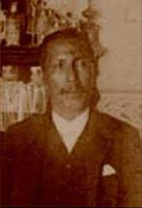

President of the Cabinet and
Secretary of Foreign Affairs: Apolinario Mabini
Secretary of the Interior: Teodoro Sandico
Secretary of War: Baldemero Aguinaldo
Secretary of Welfare, including
Public Works, Communication,
Agriculture, Industry and Commerce: Gracio Gonzaga
Secretary of Finance: Mariano Trias

Slide 41
The Council of Government, or the Cabinet, according to Mabini, “belongs to no party, nor does it desire to form one; it stands for nothing save the interests of the fatherland.
On January 23, 1899, the Philippine Republic was inaugurated at Malolos in colorful ceremonies. Aguinaldo took his oath of office after having been that he had been proclaimed President of the Republic.
The Malolos Constitution was read article by article, and the army took its oath of loyalty before the President. A review of troops and procession followed.
To make the event more memorable, Aguinaldo issued a decree granting pardon to all Spanish prisoners of war were not members of the Spanish regular army and, at the same time, granting to Spanish and other aliens the right to engage in business within the limits of the Republic.

Slide 42
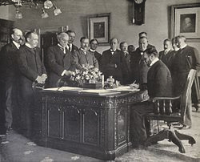
Treaty of Paris
In accordance with the Protocol of Peace signed on August 12, 1898, five American and five Spanish commissioners were appointed to meet in Paris to discuss the final peace terms between Spain and United States.

Slide 43
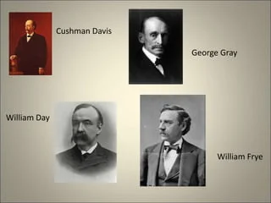
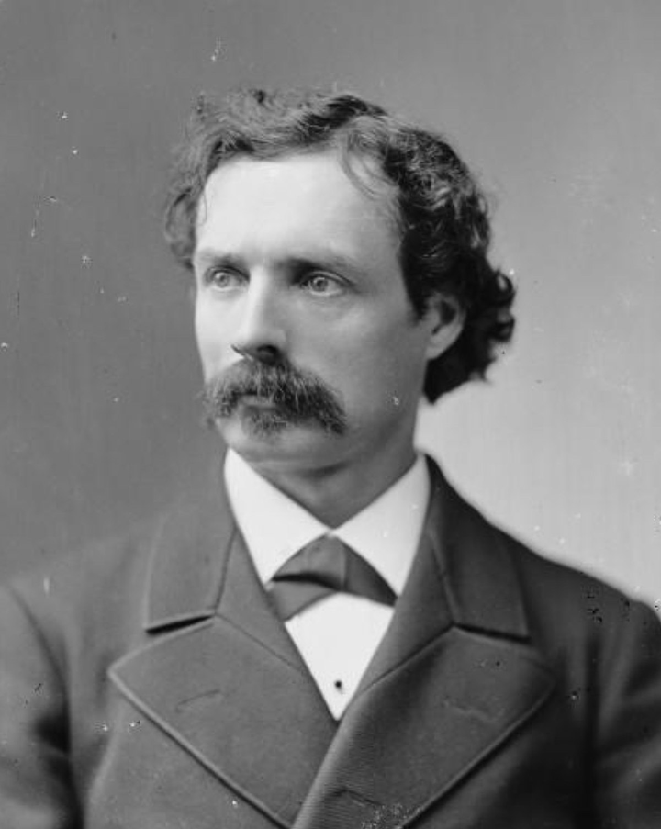
The American Commissioners were Cushman Davis, William P. Frye, Whitelaw Reid, George Gray, and William R. Day.
Whitelaw Reid

Slide 44
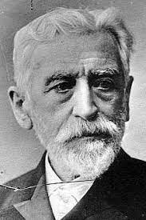
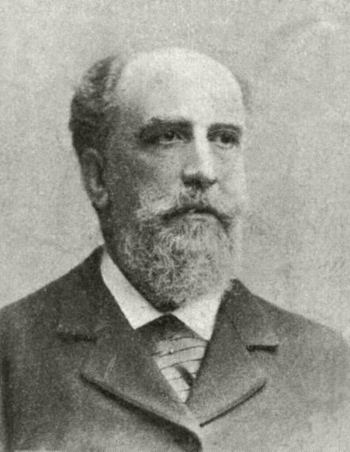
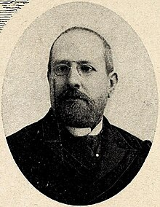
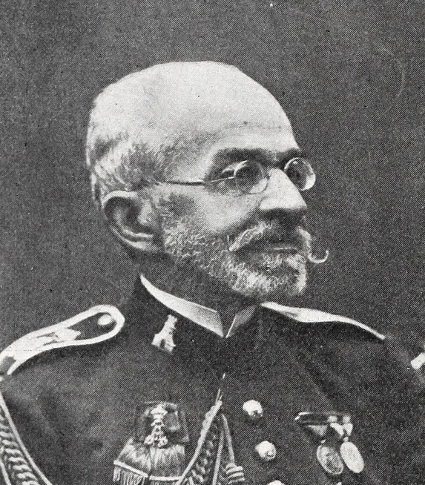
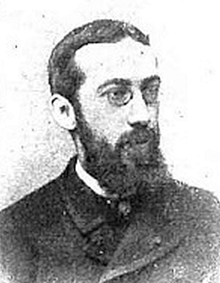
The Spanish commissioners were
Jose de Garnica
Eugenio Montero Rios
Buenaventura Abarzuza
General Rafael Cerero
Wenceslao Ramirez de Villa- Urrutia

Slide 45
The Peace Commission met in Paris from October to December 1898.
On December 10, 1898, the Treaty of Paris was signed. It provided that Spain would cede the Philippines to the Unites States in return for which they would receive $20,000,000 from the United States in return as payment for the improvements made in the colony. Further, the United States agreed to give the Spaniards the right to ship commodities to the Philippines for a period of ten years on the same terms as those of the United State.

Slide 46
The Structure of the Government (Executive, Legislative, Judiciary)
The Malolos Constitution is the first important Filipino document ever produced by the people’s representatives. It is anchored in democratic traditions that ultimately had their roots on American soil. It is created a Filipino state whose government was “popular, representatives, and responsible” with three distinct branches:
The Executuve
The Legislative
The Judicial

Slide 47
The Executive Branch
Article 56. The Executive Power shall be vested in the President of the Republic, who shall exercise it through his Department Secretaries.
Article 57. The administration of the particular interests of towns, provinces, and of the State shall correspond, respectively, to the Popular Assembles, the Provincial Assemblies, and to the Administration in power, in accordance with the laws, and observing the most liberal policy of decentralization and administrative autonomy.
The Legislative Branch
The legislative power was exercised by the Assembly of Representatives composed of delegates elected accordingly to law. To make function of Congress continuous, the document provided for a Permanent Commission which would sit as a law- making body when Congress was not in session. The Assembly elected the president of the Republic. The Cabinet, composed of the Secretaries of the different Departments of the Government, was responsible not to the President but to the Assembly.

Slide 48
The Judicial Branch
The administration of justice was vested in the Supreme Court and in inferior courts to be established according to law. The Chief Justice of the Supreme Court was to be elected by the Assembly with the concurrence of the President and the Cabinet.
The Salient Features of Malolos Constitution of 1898
Provisions making the Assembly or the legislative branch superior to either the executive or the judicial branch.
Provided for a Permanent Commission to sit as a legislative body when the Assembly was not in session.
It established a unicameral legislature.
The Constitution as a whole is a monument to the capacity of the Filipinos to chart their own course along democratic lines. In a period of storm and stress, it symbolized the ideals of a people who had emerged from the Dark Ages into the light of Reasons.

